Slide 1
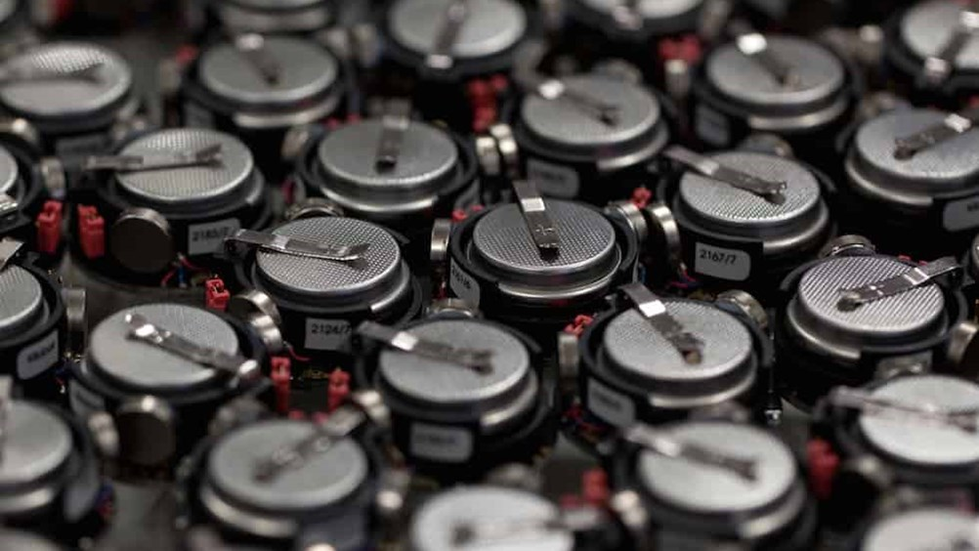





Swarm Crawler Robotics
Heilmeier Presentation 2
Marsupial
Ethan Holand, Chloe Wilson, Ethan Muhlon, Alex Storrer, Naomi Cooke
In collaboration with an EECE Capstone team:
Jarrod Homer, Maulik Patel, Ben-oni Vainqueur, Musheera Khandaker, David Antaki
Notes:
Hi, we are Team Swarm Crawler, a team of 5 MechEs in collaboration with 5 EECEs, and this is our pitch!
Chloe Wilson

Slide 2

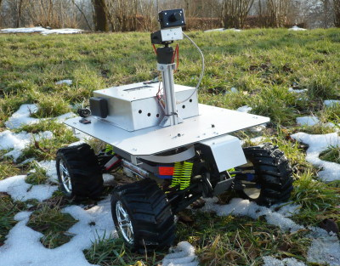
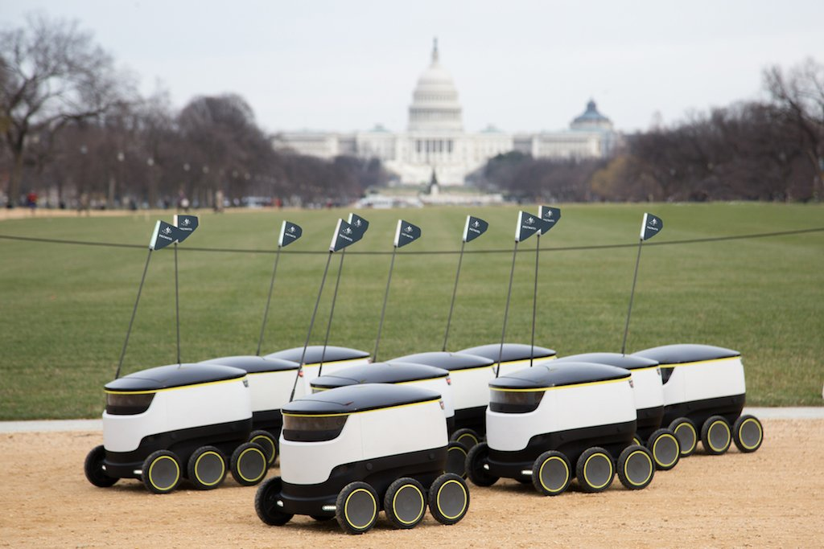
Problem Statement
Fleets of robots can distribute the workload of a field task; however, their runtime and use cases are limited by finite battery life of each system.
Mobile robots have limited battery life
Power generation
  Increases size and weight
Docking
  Stationary
  Flat terrain
Notes:
Alex
Like humans, robots working together can achieve more by dividing and conquering to share workload overcome demanding tasks. Unfortunately, multi-robot systems have limited applications due to limitations associated with their battery life and onboard storage capacity.

Slide 3
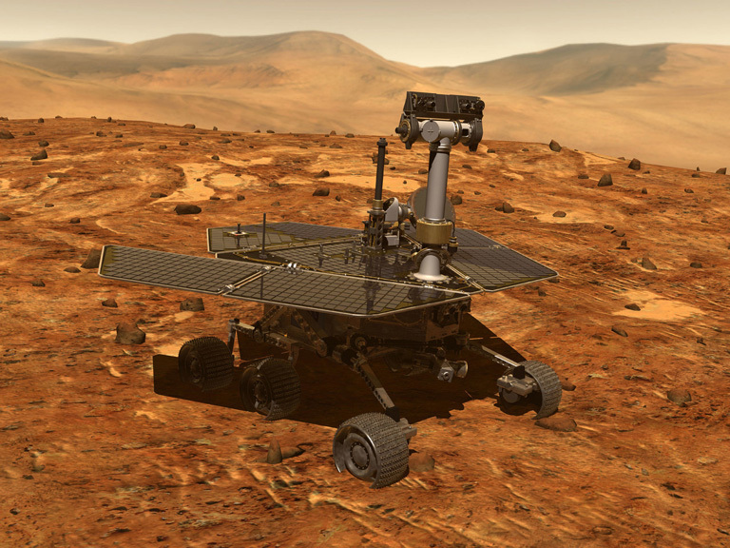
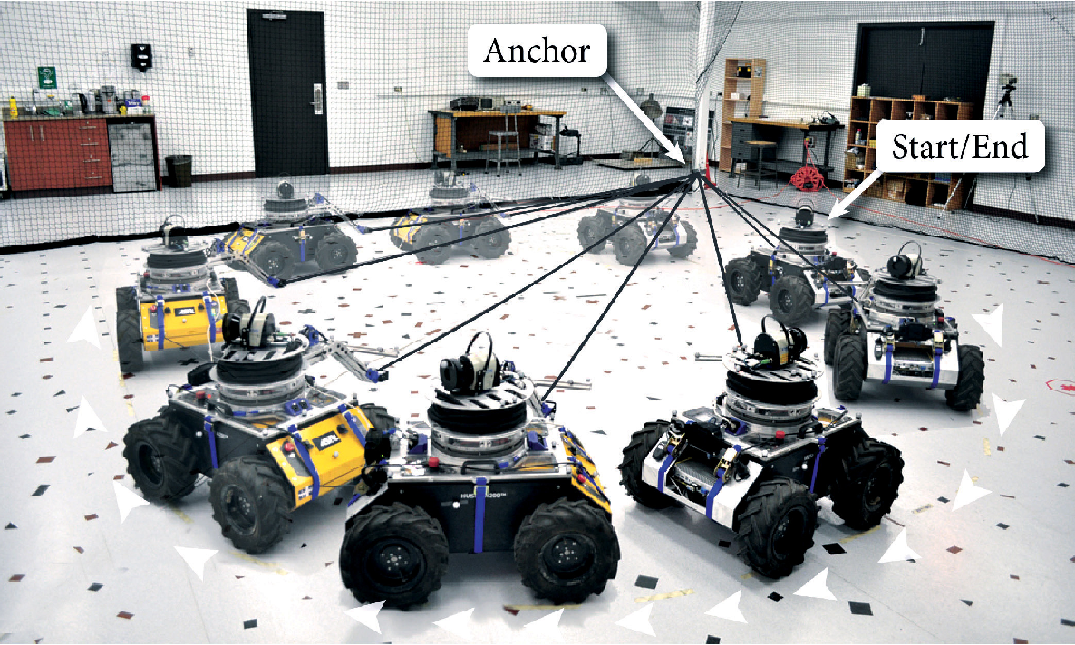
Current Solutions & their Limitations
Onboard power generation on each robot
  Increases weight, size, cost, complexity
Human intervention to collect and recharge robots
  Limits operating conditions and mission duration
Tether robots to a ground station
  Limits mobility
Notes:
Alex S
Current systems exist to address the issues associated with power and storage of mobile robots, but many of these methods have serious drawbacks which ultimately limit operational capabilities and range.
Some systems utilize onboard power generation or add bigger batteries to overcome power issues, but these solutions suffer from increase weight, cost, and overall robot size. Charging at a stationary dock and performing some kind of item exchange, or being tethered to a power cord are other common methods to address power limitations however these architectures limit the range in which the robot can operate effectively.
So what do we do???

Slide 4
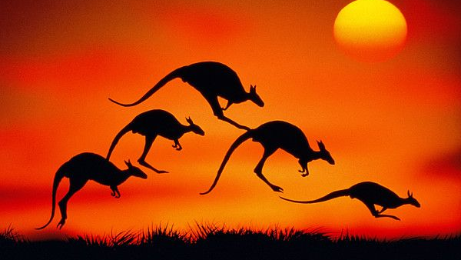
Our Solution

Slide 5
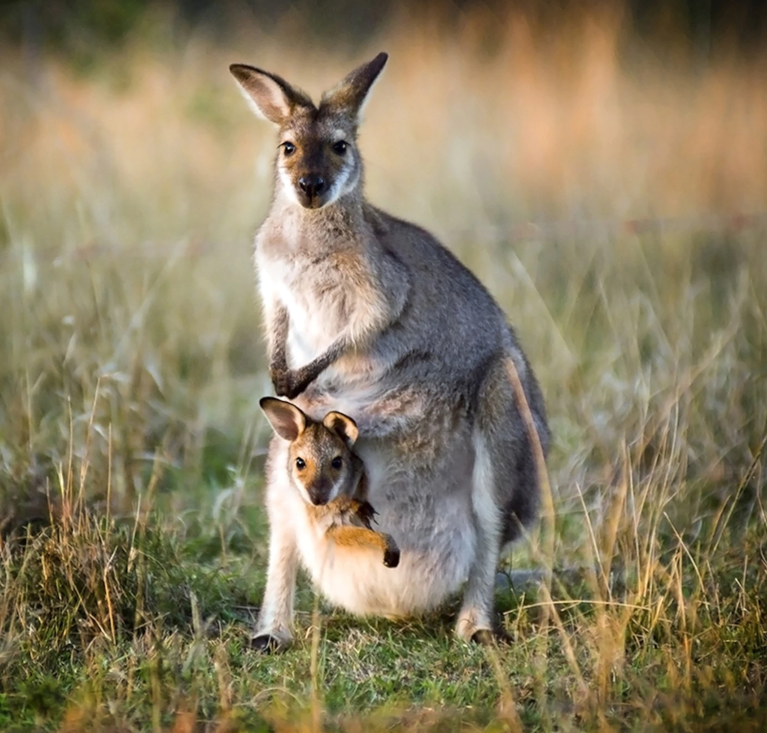
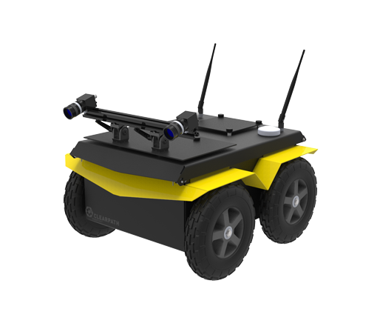
Our Solution
Field of Marsupial Robotics
  Mother robot carries and supports child robot(s)
Our Project
  One mobile mother robot, 2+ children robots
What will be new
  Robust docking over uneven terrain
  Charging from mother to multiple children robots
  Item handoff
Mother “Hub” Robot
Power
Data
Materials
Child Minibots
Notes:
Chloe W
In response to these limitations in existing solutions, we are developing a marsupial robotic system. A marsupial is a mammal like a kangaroo that can carry its young. Like its namesake, the field of marsupial robotics is characterized by a larger mother robot which provides support to smaller children robots.
Our solution will take this foundation and build upon it by developing charging between the mother and children robots, the ability to dock over uneven terrain, and demonstrate item handoff between the mother and children robots. We plan to build one mother robot with 4 docking ports to support at least two smaller children robots.

Slide 6





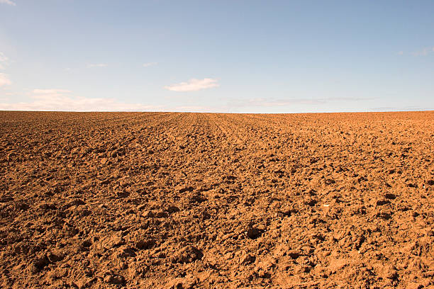


Scope
Primary Goals:
Robust docking over uneven terrain
Mobile hub providing power to mobile minibots
Stretch Goals:
Item handoff between hub and minibot
Hub can carry the minibots
Out of Scope:
Minibots interaction with the environment
Power generation on hub
Upper limit field conditions we may test on
Notes:
Chloe W
With all of these goals in mind, it was important to prioritize and narrow our scope. Our primary goal is to develop a locking docking mechanism that assists with alignment and can function even over uneven terrain. With successful docking, the minibots will be able to charge from the hub robot.
If time and resources allow, there are some stretch goals we would be curious about pursing. The first of these is item handoff, where the minibots may exchange a physical object to the hub. Finally, we may attempt to develop a docking mechanism that allows the hub to carry the minibots.
It was also valuable to identify what lies outside our scope. We will not be worrying about a physical interaction with the environment, such as picking up an object in the environment. There will also not be any power generation on the hub due to its complexity.

Slide 7

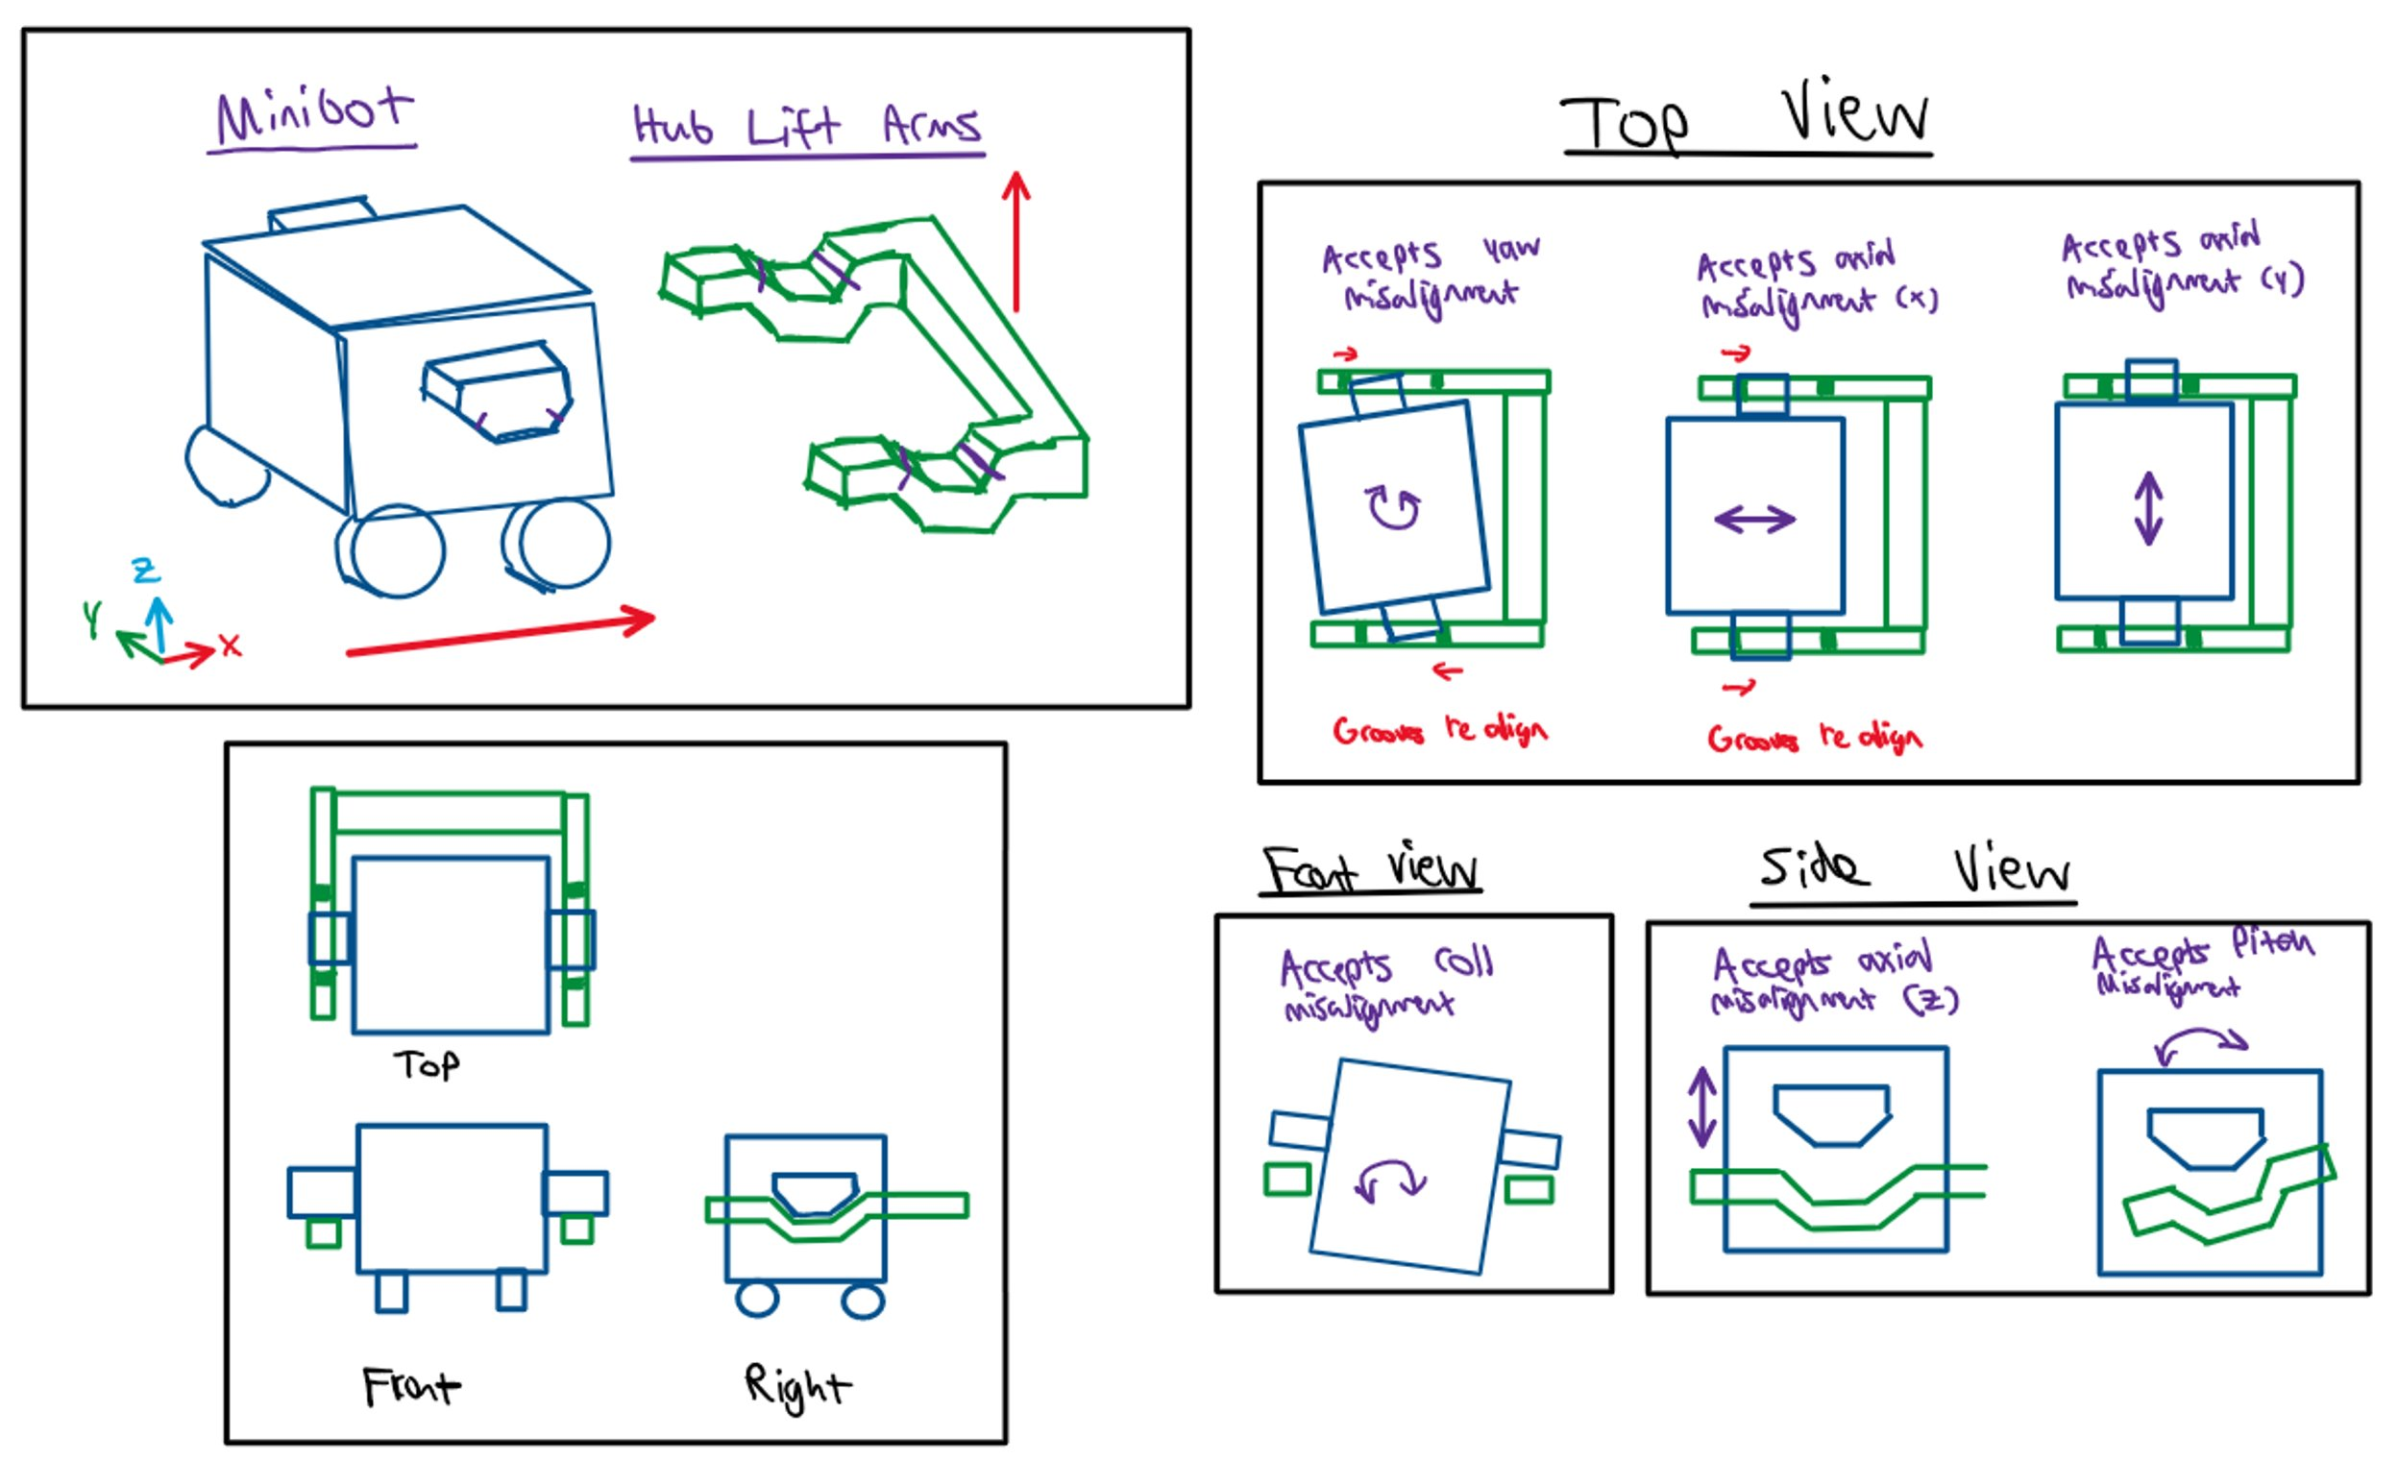
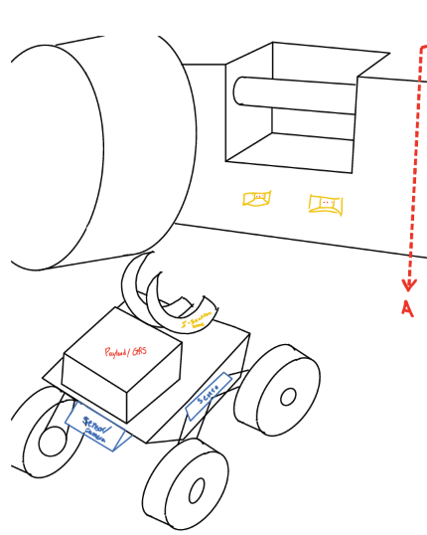
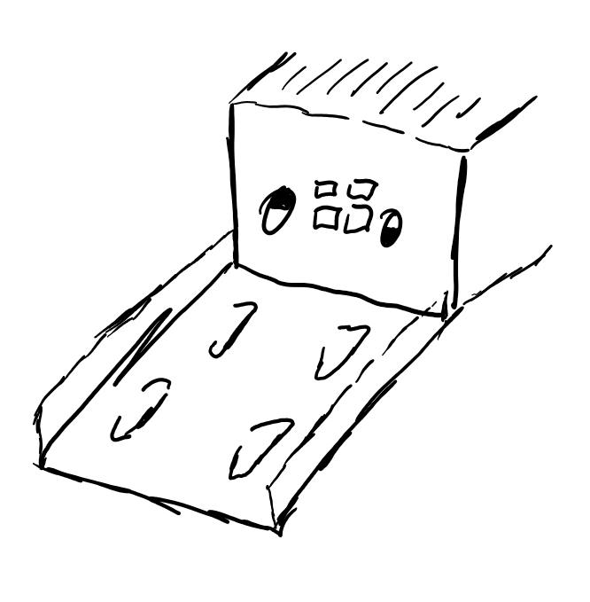
Sketches and Design Ideas
We will test as many solutions as possible on a modular testbed!
Lift Mechanisms
Ramps
Claws / Grippers
Notes:
Naomi
Priorities for brainstorming/evaluating ideas:
Solution should not actively expend power to remain docked
Minimal footprint added to on minibot
Minimal complexity (low number of actuators needed)
Minimal cost and weight
Make sure to clarify we are not pre-emptively settling on one idea, as we want to create a modular testbed to 3d print solutions and rapidly iterate through any idea with promise

Slide 8

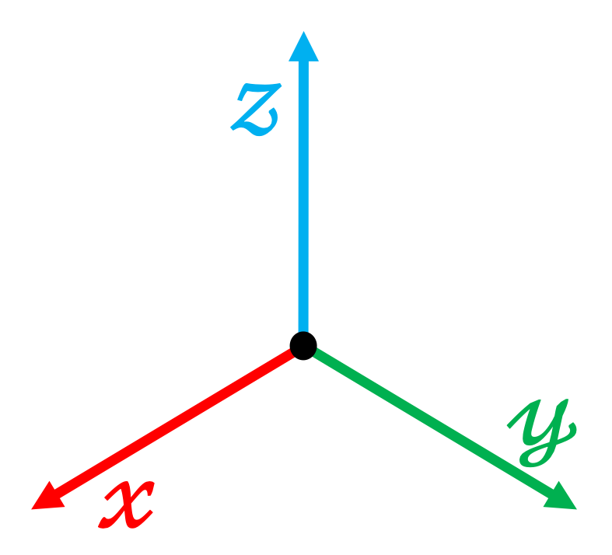
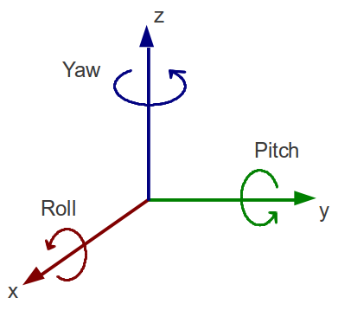
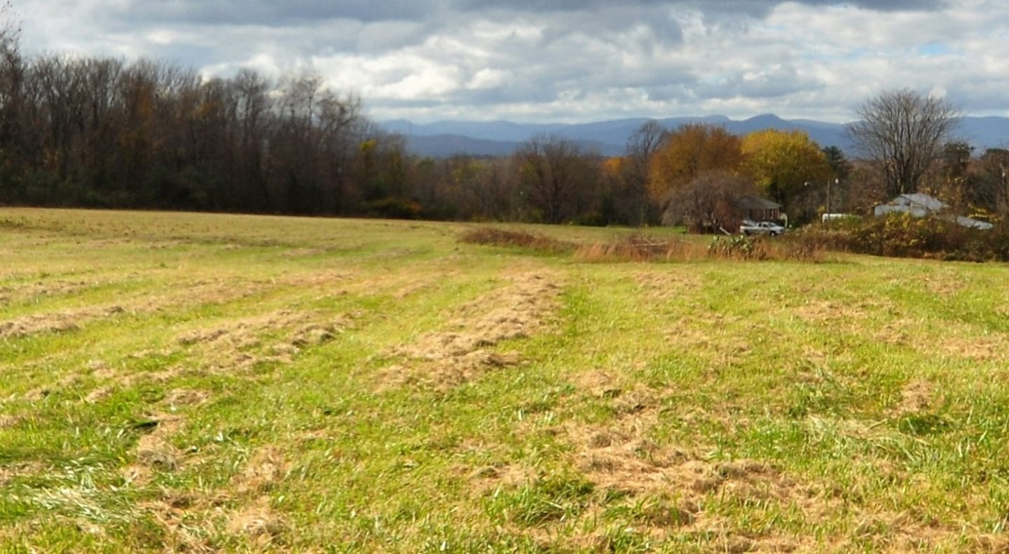
Checks for Success
Midterm Goals
Final Exam Goal
Can our dock compensate for 5 cm of misalignment?*
Target metric: >90% success rate on 30 tests
Can our dock compensate for 15° of misalignment?*
Target metric: >90% success rate on 30 tests
Can we demonstrate these capabilities in an unknown field environment?
Achieved 100 times
without failure
*The numbers are based on the tolerance region that GPS and vision-based localization will consistently enable us to enter
Notes:
Naomi C
We have developed a suite of tests that act as milestones towards achieving the primary scope of our project: docking over uneven terrain to facilitate charging.

Slide 9

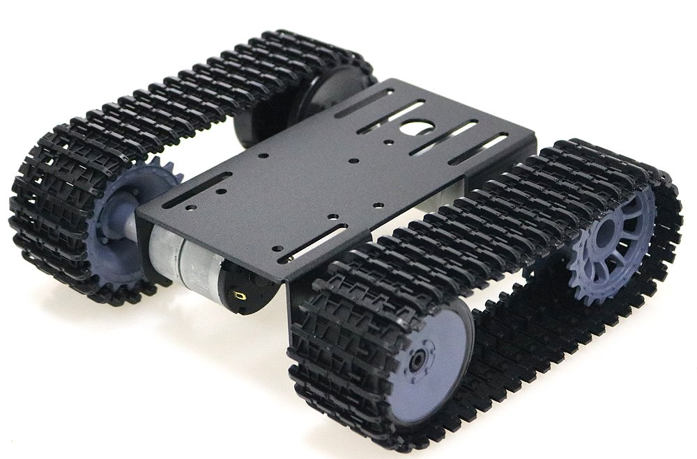
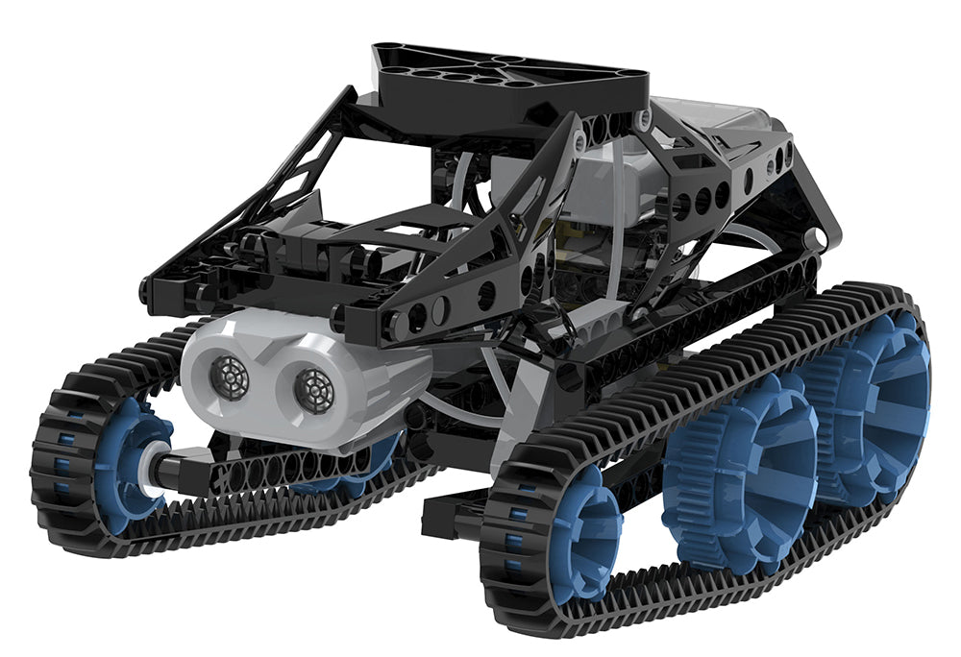
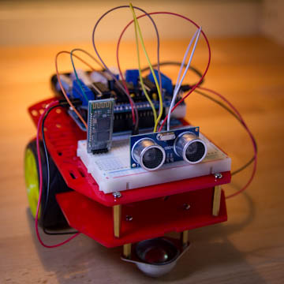

Minibot System Iteration
Minibots V1
Goal:
Platform with basic movement
Test swappable docking interface
Design Specs:
Low-cost 3D printed chassis
Simplified wheel drive
Minibots V2
Design Specs:
Off-road tread drive
Larger size to carry future payload/instrument
Goal:
Test docking on varied terrain
Minibots V2.5
Design Specs:
Instrument added
Onboard payload storage added
Goal:
Demonstrate instrument sensing
Demonstrate payload handoff
Notes:
Ethan Holand
To reduce risk, we will develop our system following an incremental process. We will start by making the first iteration minibot – a small wheeled platform capable of basic movement, with flexible mounting points for a docking interface.
We will iterate on various designs for interfaces using this platform.
Once we find an effective solution, we will develop a larger platform with more robust abilities. This will enable us to test in the outdoor world.
We will design the system to have room for future additions, such as an instrument or a payload, if time allots

Slide 10
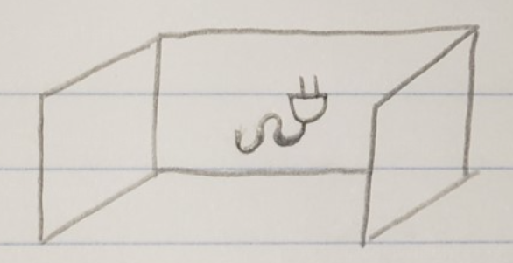
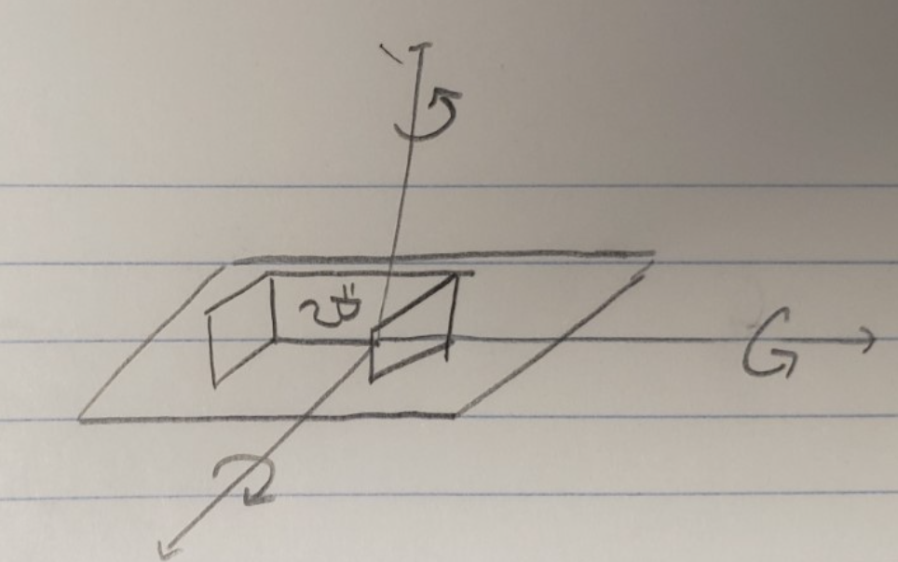
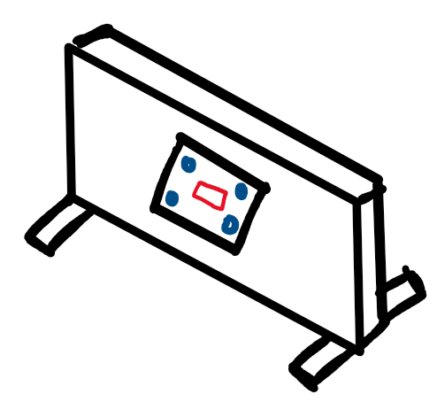
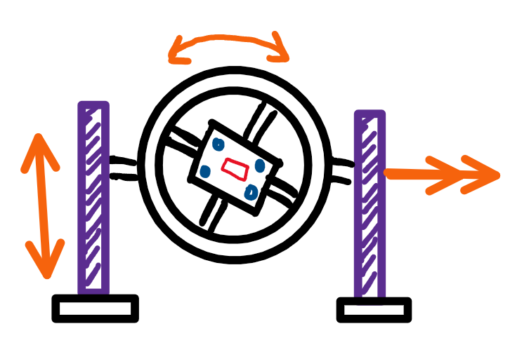
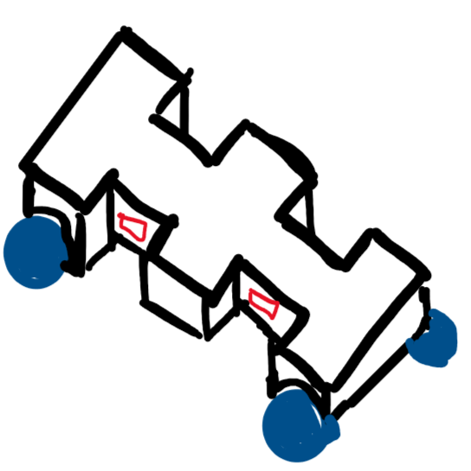
Hub System Iteration
Hub V1
Design Specs:
Flat wall
Swappable charging interface port
Goal:
Basic testbed for simple docking
3d print connectors to easily iterate docking components
Hub V1.5
Design Specs:
V1 system mounted on gimbal
Adjustable roll, pitch, yaw
Goal:
Demonstrate docking on uneven, angled terrain
Test reliability of docking
Hub V2
Design Specs:
Mobile robot
Modular frame with multiple docking ports
Goal:
Test docking in field conditions
Demonstrate battery balancing
Notes:
Ethan Holand
We will similarly iterate through a test stand to represent the hub robot. We will begin by building a simple flat wall with a swappable charging interface port.
This will be used for prelinary tests of the interface.
We will next mount it on a 3-axis gimbal to emulate the potential range of misalignment we may encounter. This will enable tests to be varied across the expected range, and repeatable. Once this is demonstrated, we will implement the most successful solution to a mobile robot hub with multiple docking ports.

Slide 11

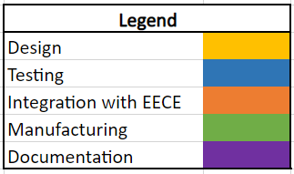

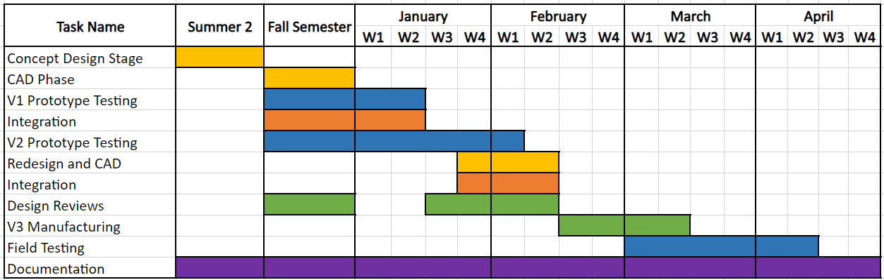
Timeline
Notes:
Ethan M

Slide 12

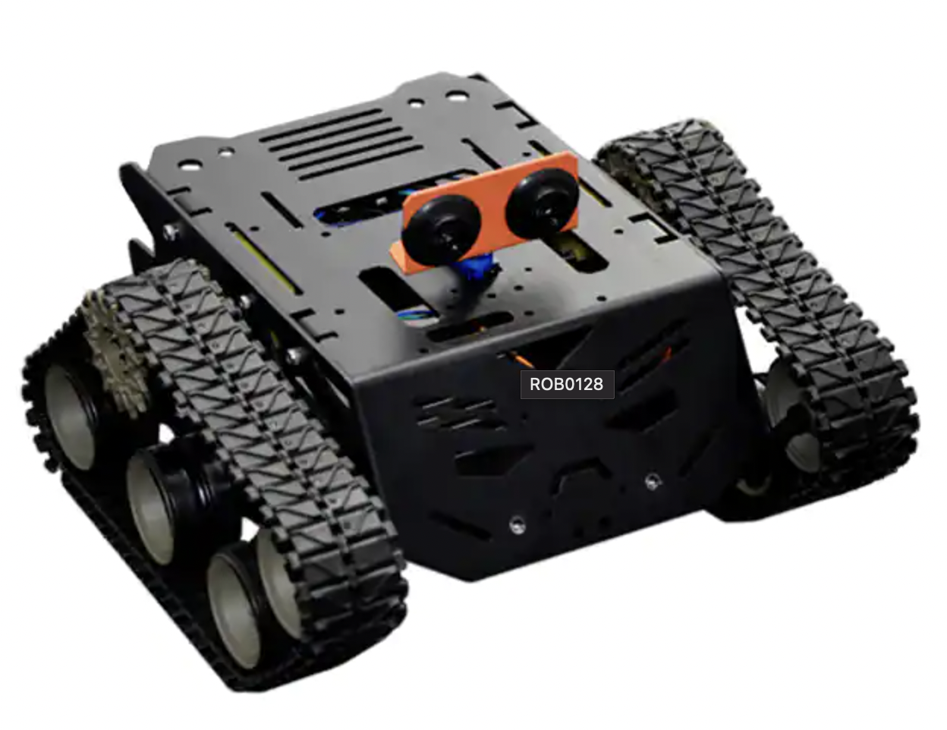
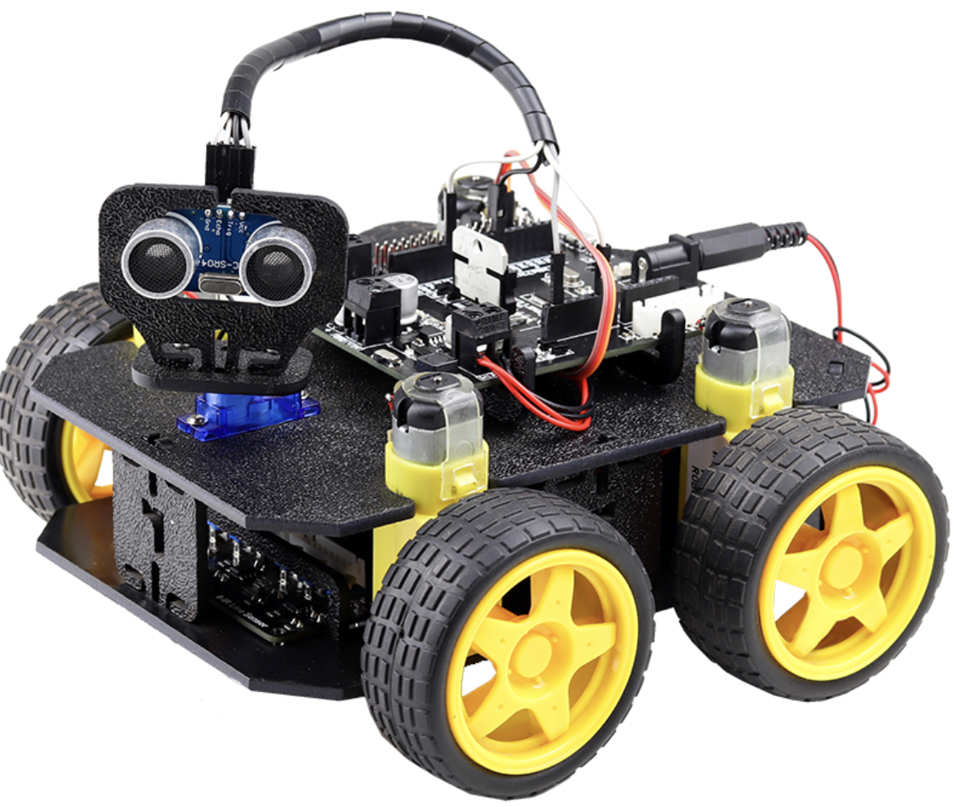
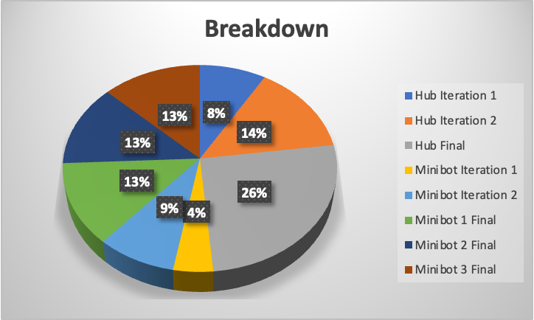
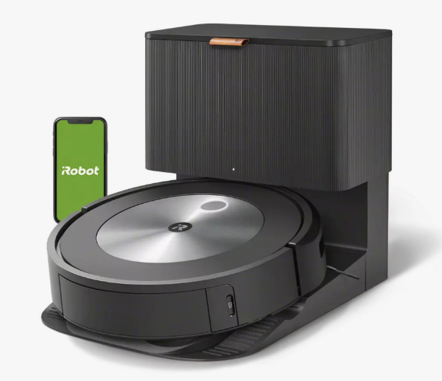
Budget
Robot | Component | Quantity | Item Cost | Total Cost
Hub Total |  | 1 | $1,700 | $1,700
 | Iteration 1 | 1 | $300 | $300
 | Iteration 2 | 1 | $500 | $500
 | Final | 1 | $900 | $900
Minibot Total |  | 3 | $600 | $1,800
 | Iteration 1 | 1 | $150 | $150
 | Iteration 2 | 1 | $300 | $300
 | Final | 3 | $450 | $1,350
Overall Total |  |  |  | $3,500
~$150
~$100
~$250
Notes:
3500 total – 1800 minibots, 600 each, 1700 hub
Materials for frame
Parts are reused between iteration
Roombas can be manufactured for roughly $250
Intro to robotics kits roughly $100
Light all terrain drive system for $150

Slide 13
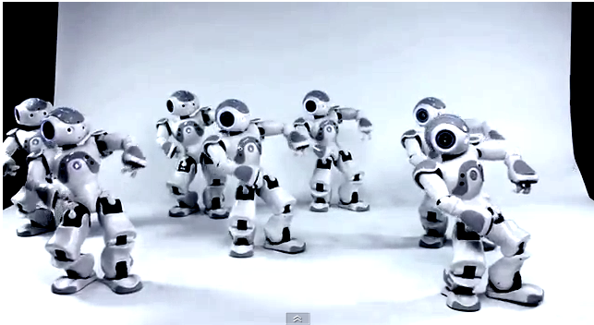
Thank you!
Questions?

Slide 14

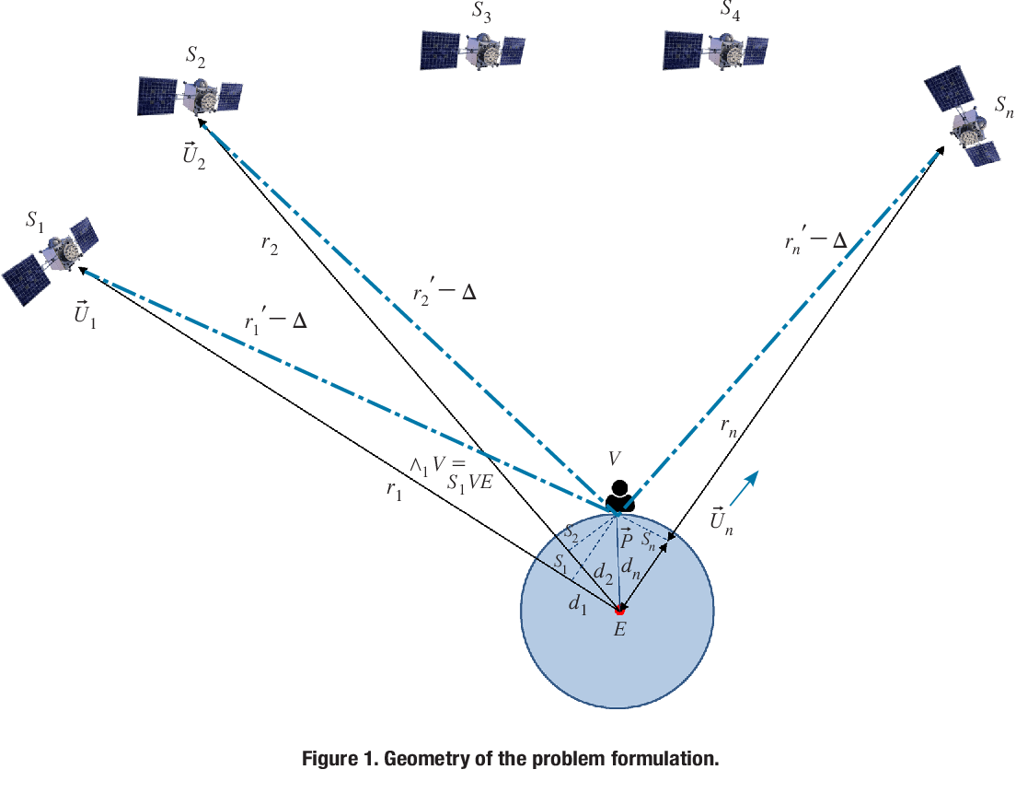
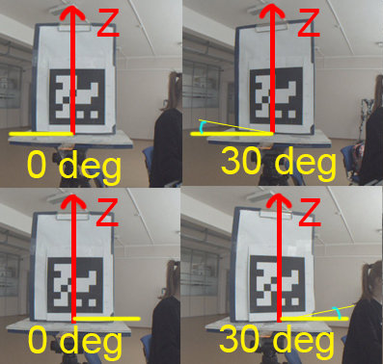
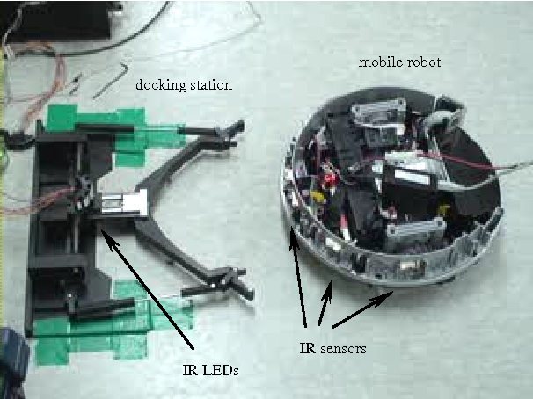
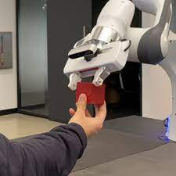
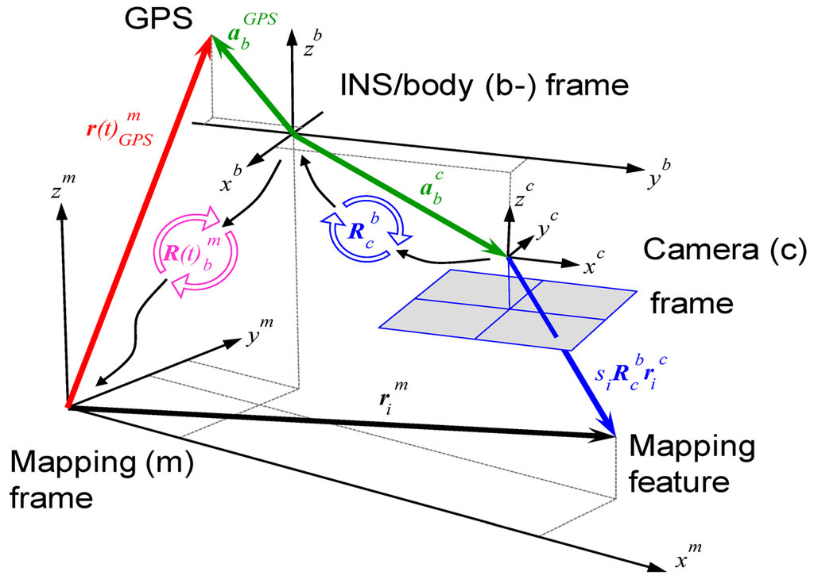
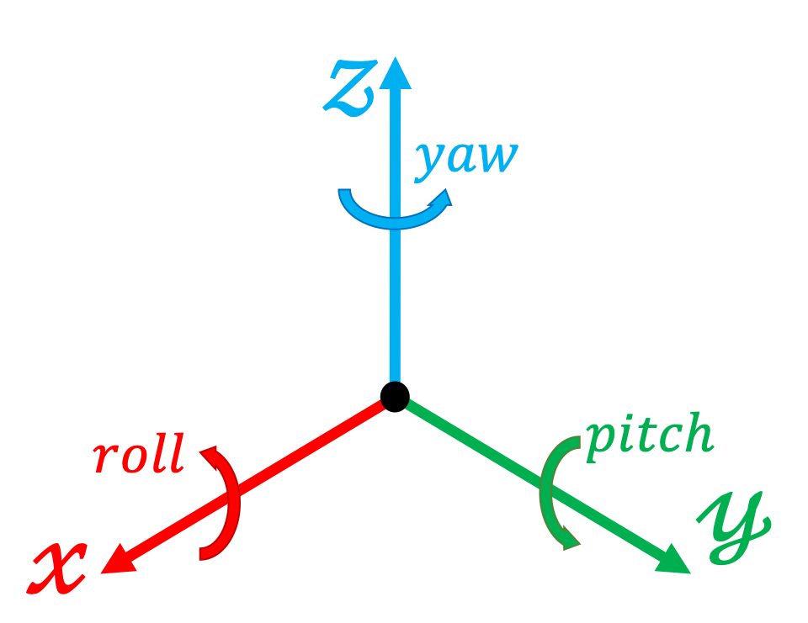
Docking Steps
Long-range GPS localization
~5 m accuracy
Near-range camera-based localization
~3-5 cm accuracy
Close-range mechanical alignment
3-5 cm of XYZ misalignment
15° of angular misalignment
Robot Exchange
Power
Data
Materials
EECE Tasks
MechE Tasks

Slide 15

Docking Procedure
Get minibot location (GPS) & orientation (IMU)
Is minibot power low?
3. Determine relative travel distance and direction
Y
Get hub location (GPS) & orientation (IMU)
N
5. Minibot uses camera vision for near-range alignment
6. Minibot drives to engage with mechanical docking mechanism
Electrical continuity?
4. Drive minibot to general vicinity of hub
Y
9. Release minibot back to the field
Fully charged?
8. Charge minibot to full power
Y
N

Slide 16





Concerns
Concerns | How to Mitigate
Scope Creep | Primary goals; Testing and milestones Secondary goals when feasible
Budget Limitations | Low-cost prototyping One final build for hub and minibots once core concepts are verified
Environmental Exposure | Scope: Dirt, grass, gravel Out of scope: Fine dust, weatherproofing
Docking Misalignment | Software and Mechanical methods Testing for each iteration
Team
Tech
Notes:
Chloe W

Slide 17
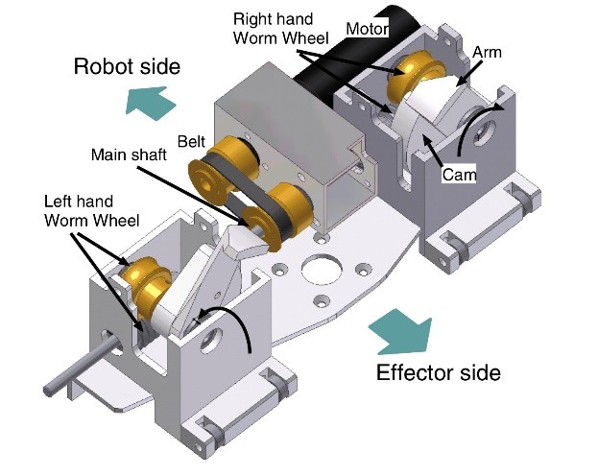
What is new in our approach?
Current Docking Mechanisms:
Are designed for flat terrain
Are designed and calibrated for known locations and environments
Our Solution (Primary Goals):
Designed for use in the irregular terrain of field environments
Notes:
Update to reflect newer scope -> based on research, limited solutions exist for recharging a fleet of robots in varied outdoor field terrain.

Slide 18
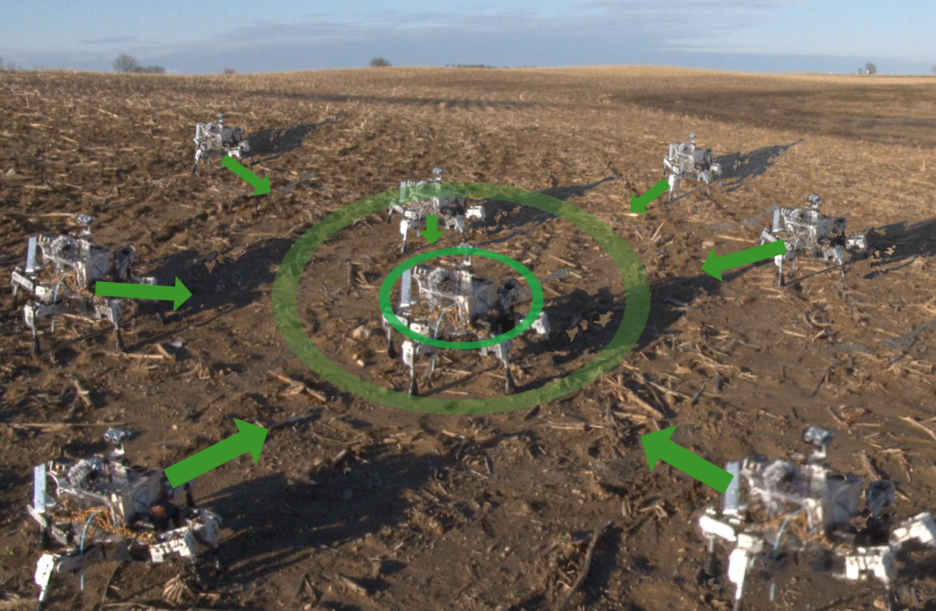

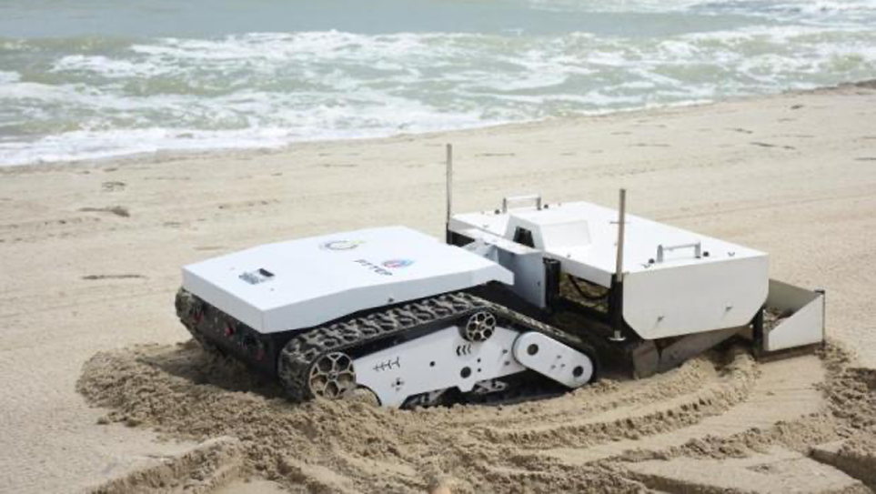
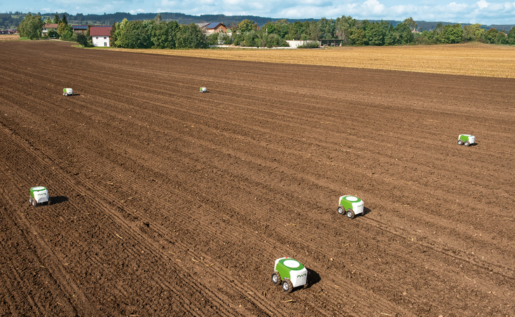
Why Multiple Robots?
Can divide and conquer --> larger area, more tasks
Hub recharges minibots for long-term operation
Beach Cleaning Swarm
Minibots collect trash, return to hub
Mars Exploration Swarm
Minibots collect samples, return it to the hub for analysis
Agriculture Swarm
Hub provides seeds to plant in field
Notes:
Our architecture can enable swarm robotics, here are all the applications!
Future project iterations
Our research applies to ALL of these! How awesome!
Divide and conquer efficiently !
Address existing limits in swarm
We are creating a proof of concept that can help revolutionize the field of SWARM robotics for future applications

Slide 19
Project Overview
What:
One mobile mother robot which supports several smaller child robots
Developing an interface to exchange power, data, & potentially materials
Mother “Hub” Robot
Power
Data
Materials
Child Minibots
Notes:
Alex
Our group aims to solve these problems by creating a robotic architecture, featuring a large mobile robot which will sustain smaller mini-bots in the field. Our focus will be on developing an interface between these systems that allows power, data, and material exchange.
We’re doing this because we see an opportunity to take swarm robotics to the next level by expanding their current operation conditions for applications outside of the home. We believe that the hub robot will provide a lifeline to sustain a swarm of minibots, enabling new field applications.

Slide 20
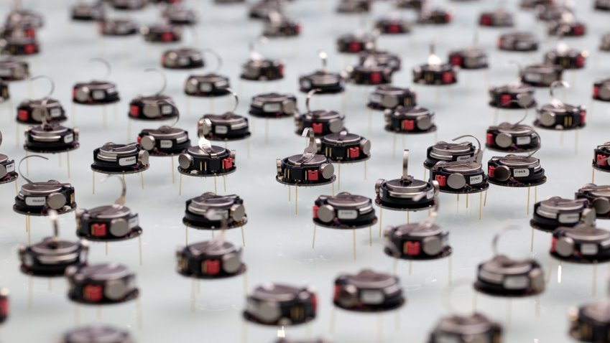
Research
Swarms, Deploying, Charging

Slide 21
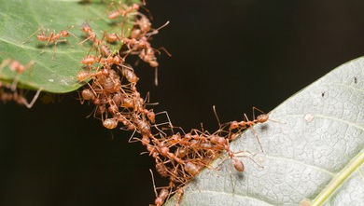
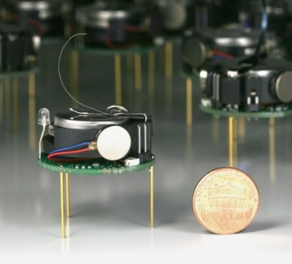

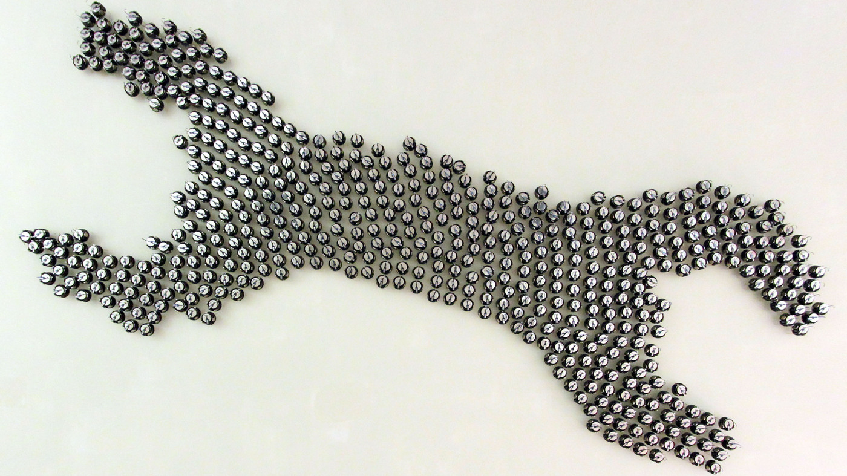



Swarm Robotics
Insect Swarm
What is a swarm?
System in which multiple units coordinate to achieve a task
[1]
Challenges of Swarm Robotics
[2]
[3]
Robotic Swarm
Deploying and retrieving
Limited battery life
Limited onboard capacity
Limited processing power
Limited size, battery, payload (penny for scale)
Notes:
Swarm robotics is a field of robotics where lots of small robot units to work together to do something. Lots of research is focused on swarms because of their ability to divide and conquer to overcome simple tasks; Current swarm robotic systems have limited applications due to shortcomings associated with their size. The complexity and deploy-ability of swarm operations is also limited when each robotic unit is identical.
%% Don’t say
A swarm of larger robots, each outfitted for a different task, would be able to overcome more complex coordination challenges and increase the use cases for robotic swarms.

Slide 22
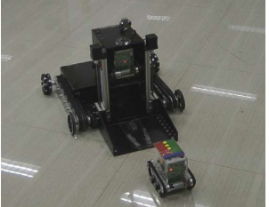
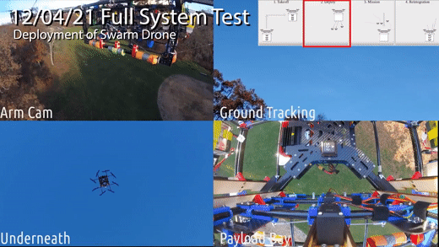
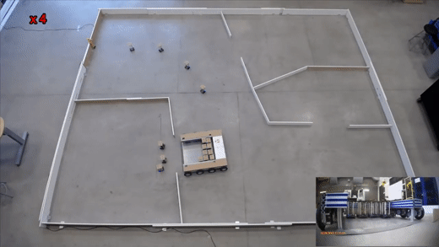
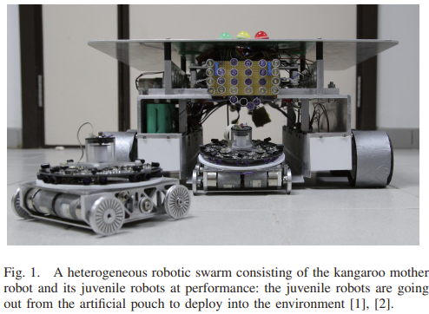
Deploying
[5]
[4]
Transporting multiple robots to a location
  Crucial for exploration, search-and-rescue, disaster relief
Current systems do not feature charging or restocking
  Limits mission duration
“Swarm Carrier”
Northeastern University, Fall 2021
“The Design of a Mother Robot for Marsupial Robotic System”
Chinese Academy of Sciences, 2014.
[6]
[7]
“A Kangaroo-inspired mothership”
More-Than-One Robotics Laboratory, University of Brunei Darrusalam, Jan. 2022
Notes:
Deploying is the act of transporting multiple robots to one location, which is crucial for exploration, search and rescue, and disaster relief applications. We have evaluated a multitude of systems to deploy small robots, as seen in the right, and found that none combine that capability with charging, which limits mission duration.

Slide 23
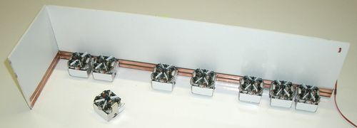

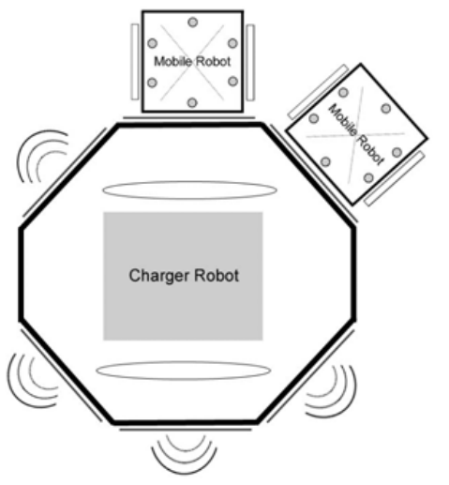

Docking & Charging
[8]
Jasmine Open-Source Robotic Platform – Wall Charging
+ Easily scales # of robots
+ Precise alignment not needed
- Stationary
- Flat terrain
- No physical connection
- Power inefficient
Ensures mobile robots can operate continuously.
Some limitations of current systems:
Limited to service applications
Flat terrain
Stationary dock
Wall power supply dependent
Weak connections
[9]
[10]
University of Putra Malaysia Moveable Charger
Roomba i7
+ Mobile base
- Needs precise alignment
- No physical connection
+ Material transfer: empties onboard storage
- Flat, known terrain
- Wall Power
+ Charges 8 robots
- Single robot
- Stationary dock
Notes:
Currently, other robotic systems exist which interface with a dock to exchange a payload and or power. Many of these systems are developed for consumers as service robots, which are typically outfitted for relatively flat surfaces and utilize a stationary docking point.
Additionally, most existing docking robots rely on a wall power supply for energy generation and have very weak docking/charging mechanisms, further limiting their use cases outside of the home.
%% Idk if I want the rest of this note.
We see an opportunity to bring swarm robotics to the next level by expanding their applicability with use of robust docking mechanism and the ability to exchange goods and power on dynamic terrain.

Slide 24

Hub and Minibot Architecture
We will develop:
1 ground-based hub to deploy and sustain
2-4 minibots
Hub will provide minibots:
Transportation
Charging
Restocking and/or item retrieval
Payload
Hub Robot
Minibot
Docking Interfaces
Notes:
Our answer to these limitations in existing technology is a hub and minibot architecture. What you see here is a concept sketch that does not reflect any final design decisions, but it does help to illustrate our plan moving forward.
The first key aspect is the hub robot. This will be a large mobile robot with up to 4 docking ports. External minibots will be able to drive up to these ports and dock to the hub, enabling them to charge from the hub's power supply and exchange data and information. The hub will be able to lift and carry the minibots, allowing the entire system to easily transport to a secondary location. One final goal is payload exchange. The minibots will be able to carry a material object, a payload, and exchange it with the hub. We hope to develop 2-4 minibots, depending on time and resources.

Slide 25




How it Addresses Current Limitations:
Previous Limitations
Difficult to deploy and retrieve
Limited battery life
Limited onboard capacity
Limited processing power
Solutions Provided by Proposed System
Single point of retrieval
Hub generates power & charges
Minibots restock (or deposit) items at hub
Heavy computation done by hub
Notes:
Our architecture can enable swarm robotics, here are all the applications!
Future project iterations
Our research applies to ALL of these! How awesome!
Address existing limits in swarm

Slide 26



Scope and Priorities
Scope: Develop a general proof-of-concept to allow for future research and development in specific applications
End goals:
Demonstrate deploying and re-docking of minibots
Demonstrate distribution of power from hub to minibots
Demonstrate exchange of goods between hub & minibots
`
Core Objectives
Stretch Goal
Notes:
During development, we will focus on building features to demonstrate the unique value provided by hub in supporting a swarm. This means that the end function of the swarm itself will take a backseat – rather, we will focus on developing robust interactions between the hub and a swarm.
Our project has three pillars of success. First, we seek to demonstrate the ability to deploy and re-dock a minibot to the hub. This will enable the hub to act as a transporter. Special focus will be provided towards docking and deploying on uneven terrains.
Next, we seek to demonstrate the distribution of power from the hub to the minibots.
Finally, we hope to achieve an exchange of goods between the hub and the minibot

Slide 27
Who cares?
Why it Matters

Slide 28
Future Applications
This architecture can enable sustained “divide-and-conquer” operation, revolutionizing field robotics.
Here are a few next steps after we prove the core technology in capstone:
Beach Cleaning Swarm
Minibots collect trash, return to hub
Mars Exploration Swarm
Minibots collect samples, return it to the hub for analysis
Agriculture Swarm
Hub provides seeds to plant in field
For all scenarios, the hub re-charges the minibots to sustain long-term operation!
Notes:
Our architecture can enable swarm robotics, here are all the applications!
Future project iterations
Our research applies to ALL of these! How awesome!
Divide and conquer efficiently !
Address existing limits in swarm
We are creating a proof of concept that can help revolutionize the field of SWARM robotics for future applications

Slide 29
References
[1] https://phys.org/news/2006-02-swarm-behavior.html
[2] https://arstechnica.com/science/2014/08/thousand-robot-swarm-assembles-itself-into-shapes/
[3] https://www.npr.org/sections/thetwo-way/2014/08/14/340362573/do-not-fear-this-giant-robot-swarm
[4] https://youtu.be/lHyu_yog6CA
[5] https://ieeexplore.ieee.org/document/6885778
[6] https://youtu.be/okxFEFh7-1E
[7] https://ieeexplore.ieee.org/document/7090497
[8] http://www.swarmrobot.org/PowerDockingStation.html
[9] https://ieeexplore.ieee.org/document/5189756
[10] https://www.irobot.com/en_US/roomba-vacuuming/robot-vacuum-irobot-roomba-s9-plus/S955020.html
Notes:
Old references:
[8]https://www.youtube.com/watch?v=Ire53aZlf6E&ab_channel=SharkHome
[9] https://ieeexplore.ieee.org/document/4913144
[10] https://ieeexplore.ieee.org/document/1642218

Slide 30
What does “item transfer” entail?
Swarm robots have limited space onboard to store items
The hub robot can act as a depot for Item Restocking or Item Depositing:
Item Restocking
Item Depositing:
Where do we stand?
Considering demonstrating two-way transportation of an abstract item.
For example, moving a small box back and forth between minibots and the hub.
MiniBot
MiniBot
Hub
Hub
MiniBot
MiniBot
Example use cases:
Planting seeds
Spreading fertilizer
Planting saplings
Examples use cases:
Delivering geological samples
Delivering garbage

Slide 31



Biggest Challenges
Team Challenges
Communicating w/ dual team
Task dependencies
Funding
Ambitious number and scope of priorities
Technical Challenges
Uneven terrain
Sample retrieval system
Power management

Slide 32
Appendix A – Priority Matrix
Complexity | #Minibots | Minibot Payload | Hub mobility | Hub mechanical function | Degree of autonomy | Terrain Difficulty | Docking interface | Minibot <-> hub item exchange
Min | 1 | None | immobile | None | None | Flat, smooth | Precise alignment needed | None
 | 2 | None | Mobile | None | Auto docking | Ramps | Precise alignment, needed | None
 | 2 | Yes | Mobile | Restocks minibots | Minibot autonomy | Elevation changes and minor obstacles | Self-aligns w/ straightforward approach only | None
 | 2 | Yes | Mobile | Restocks minibots and/or collects from minibots | Minibot autonomy+ Auto docking | Basic offroading | Self-aligns w/ multiple approaches | Yes
Max | 4 | Yes | Mobile | Restocks/collects from minibots, battery swap | Minibot+hub bot autonomy, Auto docking | Rough, offroad conditions | Self-aligns off multiple approaches | Yes

Slide 33



Appendix B - Types of Robotic Swarms
Homogenous Swarm
Heterogenous Swarm
All units are identical
  EX: Ants
Some units are different
  EX: Bees
Notes:
AS: I think this is a hidden slide ☺

Slide 34
Appendix C – Communications Overview
Unidirectional hub communication
Bidirectional hub communication
Inter-swarm communication
MiniBot
MiniBot
MiniBot
HUB
HUB
HUB
MiniBot
MiniBot
MiniBot

Slide 35



Appendix D – Power/Data Interface Example
Spring Loaded
10.2 mm

Slide 36

Appendix E: Organization

Slide 37

Organization System
Shared inbox/calendar
Teams channel
Sharepoint
Asana
Onenote

Slide 38



Shared inbox/calendar
Or type “swarm crawler” on the To: line
Email the entire group at once by contacting epiccapstoneproject@northeastern.onmicrosoft.com
Shared calendar w/ all meetings

Slide 39



Sharepoint / Onedrive
Centralized, cloud-based file sharing
Version history for all files: tracks who changed & when, ability to restore

Slide 40

Teams Channel
Team communication
Syncs with file sharing system
Schedule virtual meetings
Relevant tabs/files on top bar

Slide 41


Asana
Project/task management software
  List, board, calendar, gantt chart capabilities
Acquired premium version for free (typically $110/month)
Assign tasks to people, add deadlines, tags, dependencies, priorities
Outlook calendar sync

Slide 42


OneNote
Fully attached to Sharepoint/Onedrive
Meeting notes
Wiki
Brainstorming
Consistent meeting template:

Slide 43

Battery sizing
Hub will have 2x 200 Whr 6S LiPo Batteries
Minibots will have 1x 100 Whr 6S Lipo Battery each
Hypothetically a 100 W solar panel would fit on the hub robot
This would take ~10 hours to charge
2 Day charge time with 6 hours of sunlight per day at 80% efficiency

Slide 44
FAQ
Questions revolving around how 10 person team works
  Consolidated Teams channel for all teams communications, weekly full-team meeting 2x weekly subteam meetings per group – but we always make sure to have a representative from the other group. Notes taken for all meetings in shared Onenote document. Shared Asana workspace for task management.
How will you complete all of this?
  Consistent meetings, well-planned task-management, scope evaluation and re-evaluation, and personal responsibility
How are you organizing your team ?
  We have spent several weeks laying the groundwork for our organization system. See the organization slides in this presentation!
What will these robots look like?
  Form follows function! Not fully sure yet
Are you designing these robots from scratch? Why are you doing this over using an off the shelf base?
  Hub requires novel mechanical design that cannot be easily adapted from existing technology. Minibots could be adapted from other robots, such as turtlebots, and may be for initial prototyping. However, the end goal is a fully custom system.
What mechanism will be used for power transfer?
  This is mostly up to the electrical team. See Appendix D
How will you build this project under the given budget?
  We will be seeking sponsors to fund any excess costs of the project. We already have been sponsored by Asana, and they have given us $1,000 in free software access!
Why not just have solar panels on the mini-bots?
  Multiple reasons- this means all power has to be solar, which is not always practical in certain conditions. Perhaps a bigger reason is the cost/space/weight issue –putting solar panels on each bot adds up much more than a charging port would.

